Slide 1
Movie Data Analysis
By : Russell
Linkedin : Russell Njata

Slide 2
Project Background
The movie industry is one of the faster growing industries in this world
The trend of movies’ genre changes along with the time
We want to know how success the director and the actor during their career

Slide 3
Defining the problems
How is the movie’s genre trend before 2000 and after 2000?
How are the mean revenue and the mean budget of top 3 genres each year after 2000?
Who is the top actors and the top directors based on the movie that has been clustered after 2000?

Slide 4
Data Cleaning and Preprocessing

Slide 5
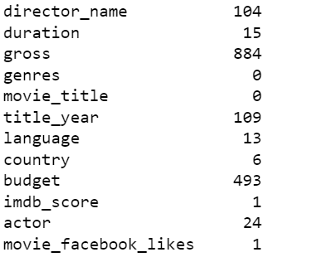
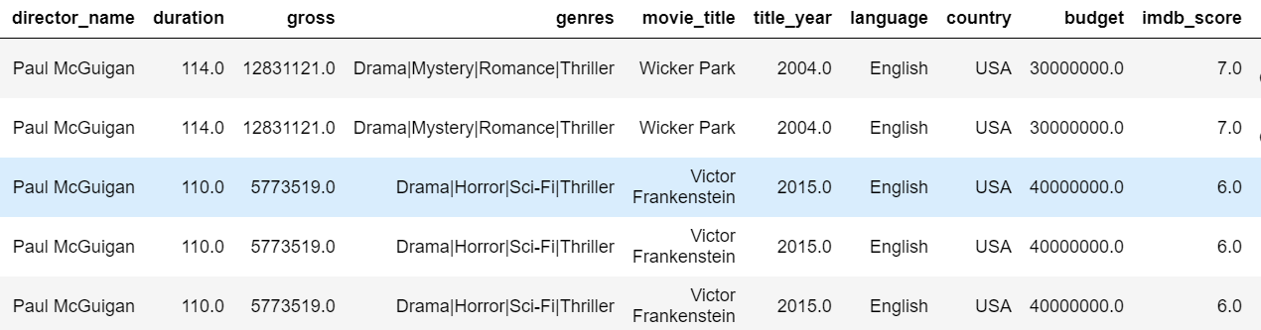
Data cleaning
There is a lot of null value in this data, especially in the gross and budget column, however I need to remove all the null value since the analysis heavily related to the budget and gross data
I also drop all the duplicates data and keep only the first value

Slide 6
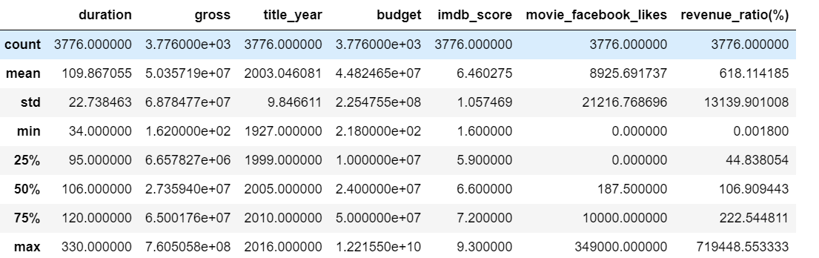
Data Preprocessing
As the description in the picture, I can see the max budget has a number multiplied by exponential 10. However the mean and the standard deviation only reach exponential by 8.
I decided to call all data in budget that has exponential by 9 as outliers. I remove the outliers

Slide 7
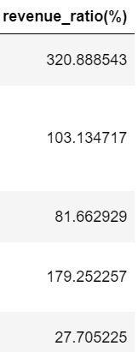
Data Preprocessing
I make a revenue ratio column to show the rate of the gross divided by the budget. If the value is below 100 then the movie earns less than their original budget

Slide 8
Data Analysis and Data Visualization

Slide 9
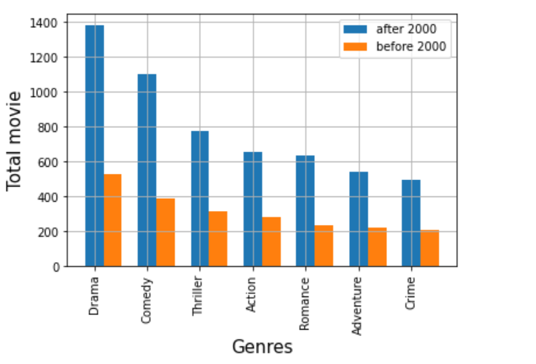
Top Genres Before and After 2000
This is the bar chart of top 7 genres movies before 2000 and after 2000. There is no order difference between before 2000 and after 2000. However, there is a significant increase in the number of movie in the year after 2000.
Drama movie is always been the top of the favorite genre.

Slide 10
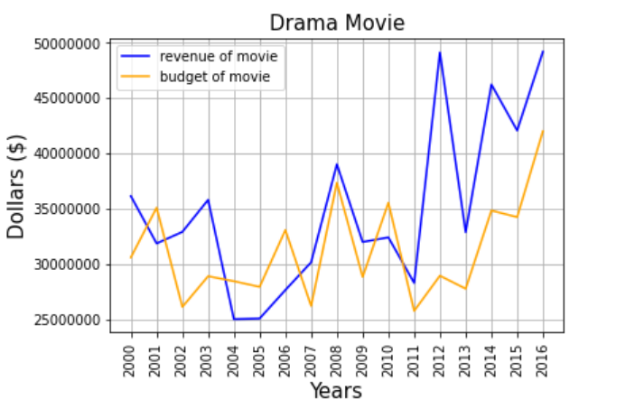
The Average Revenue and Budget of Top 3 Genres Each Year
The analyzation focused on the revenue and budget of movie that has drama genres each year after 2000
The peak of the revenue happened in 2012 and 2016, while in 2004 to 2005 drama movie gets the lowest revenue in the last 16 years.

Slide 11
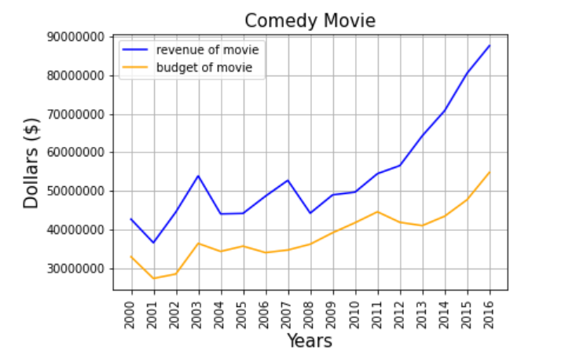
The Average Revenue and Budget of Top 3 Genres Each Year
The analyzation focused on the revenue and budget of movie that has comedy genres each year after 2000
The revenue and the budget is constantly going up
The average revenue of comedy movie gets the highest revenue for around 88000000 since 16 years .

Slide 12
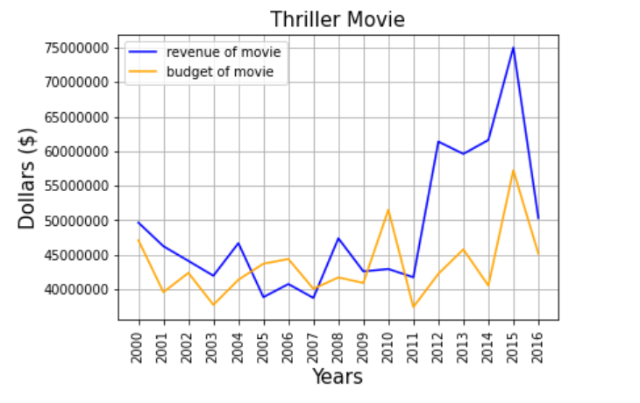
The Average Revenue and Budget of Top 3 Genres Each Year
The analyzation focused on the revenue and budget of movie that has thriller genres each year after 2000
The average revenue of the thriller movie fluctuates during the last 16 years
There is a significant increase in the average revenue from 2011 to 2012

Slide 13
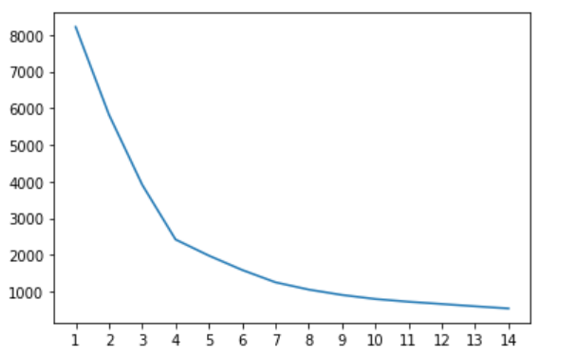
Machine Learning : Clustering
I applied clustering algorithm in this movie data in order to get top movie based on their gross/revenue, IMDB score, and the revenue/budget ratio
I standardize the value using standard value in order to reduce the bias of higher value in the data
I graph an elbow method of this data to know the best “K”. I got K = 4, so the movie will be clustered into 4 tier

Slide 14
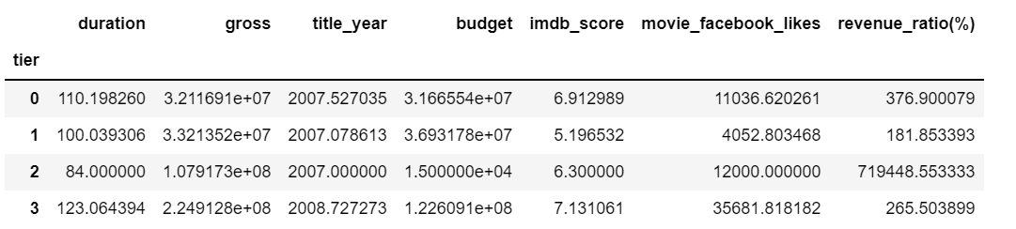
Cluster Explanation
I found out the mean score of each tier. I consider the movie tier 3 as top movies after year 2000, while the tier 1 is considered as a bad movies
The tier 2 movie is an exceptionally top movie

Slide 15
Tier 2 : Exceptional Top Movies
Paranormal Activity is an exceptional top movies based on the revenue rate.
The movie itself does not get a pretty good IMDB score, however the movie did not spend much on budgeting
The earning of this movie is the one of the highest in this data

Slide 16
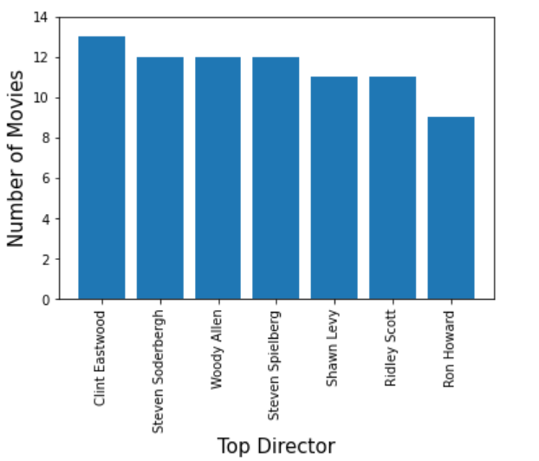
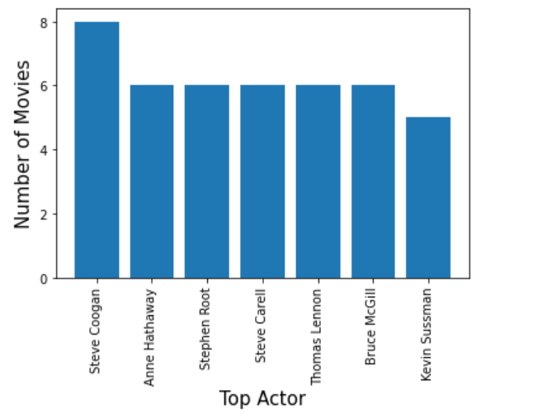
Top Director and Top Actor of Top Movies After Year 2020
Here is the list of top 7 actors and directors who played the most in tier 3 movies which is top movies

Slide 17
Conclusions

Slide 18
Conclusions
The top genre of movies does not change much during all the time. The top genre ranked in order : drama, comedy, thriller, action, romance, adventure, crime.
If you are looking for a stable and profitable movie, go for a comedy movie.
If you are looking with less-stable, profitable, and rarely get a higher revenue rate, go for a drama movie.
If you are looking for a top movie, I recommend to check out my graph of the top 7 directors and top 7 actors since they have more experienced in directing or playing in top movies.

